Slide 1
Run2 TDC main function test
Jin-Yuan Wu, Grass Wang
Da-Shung Su, Wen-Cheng Chang
2012/Oct/02

Slide 2
New Design
We started it from scratch, only keep the FPGA input/output port.
The new TDC is based on multi-sampling principle. The TDC card records hits only, so that we don’t need zero suppression.

Slide 3
Circular Buffer Timing Window
TFQ
D
TCQ
LD
LD
CK250
WA
AllShift
RegPipe4a
D
RA
LD
CK62
SRAM256x16
The hits stored in Register-Pipe (RegPipe4a) blocks are readout when Load (LD)=1, every 4 clock cycles at 62.5 MHz and the hits being readout are cleared at the end of Load (LD)=1 pulse when AllShift=1 for 1 cycle at 250 MHz.
Data from a group of 4 channels are written into one of the 2 (or 4, 8) circular buffers i(SRAM256x16 ) to wait for trigger.
The hits in the Register-Pipe are written to the circular buffer every 64 ns per hit.
If the Register-Pipe is filled with 4 hits, it takes 256 ns to write them into circular buffer.

Slide 4
Number of Circular Buffers
SEL [7:5] | Number of Circular Buffers | Circular Buffer Size | Buffer Timing Window | CIP Time
000 | 8 | 32 | 512 ns (-256 ns) | 32 x 16 x 16 ns = 8 us
001 | 4 | 64 | 1024 ns (-256 ns) | 64 x 16 x 16 ns = 16 us
011 | 2 | 128 | 2048 ns (-256 ns) | 128 x 16 x 16 ns = 32 us
WA/RA
7
6
5
4
3
2
1
0
SEL[7:5]=000
WBK[0:2]
WA[4:0]
SEL[7:5]=001
WBK[0:1]
WA[5:0]
SEL[7:5]=011
WBK[0]
WA[6:0]
Data from a group of 4 channels are written into one of the 2 (or 4, 8) circular buffers (SRAM256x16) to wait for trigger.
Number of circular buffer is controlled by the users using register bits SEL[7:5], only three bit pattern are supported at this time.
These buffer size corresponding to hit accepting window of 512, 1024 and 2048 ns. Due to effect of the Register-Pipe, the 100% hit accepting windows are 256 ns narrower.
When a trigger arrives, writing address are pointed to the next circular buffer and the current circular buffer is readout.
The readout address follows the same circular buffer setting.
The times needed to copy hits from circular buffer to event buffer, i.e., the copy in progress (CIP) times are shown above.

Slide 5
Event Buffer Configuration
WA
9
8
7
6
5
4
3
2
1
0
M[2:0] | Number of events | Max. number of words/event
5 | 32 | 32
4 | 16 | 64
3 | 8 | 128
2 | 4 | 256
1 | 2 | 512
0 | 1 | 1024
M[2:0]=5
Nevt[0:4]
CNT[4:0]
M[2:0]=4
Nevt[0:3]
CNT[5:0]
M[2:0]=3
Nevt[0:2]
CNT[6:0]
M[2:0]=2
Nevt[0:1]
CNT[7:0]
M[2:0]=1
Nevt[0]
CNT[8:0]
M[2:0]=0
CNT[9:0]
The total size of the event buffer is 1024 x 32-bit words. It can be configured by the users into 1, 2, 4, 8, 16, 32 blocks each storing an event.
The event buffer can be read and written from VME interface.
The module can be retriggered while VME is reading out previous events. The new events will be copied into different event blocks.
If too many triggers are sent to module within short time interval, old events will be overwritten. The trigger system should be designed to prevent overwritten from happening.

Slide 6
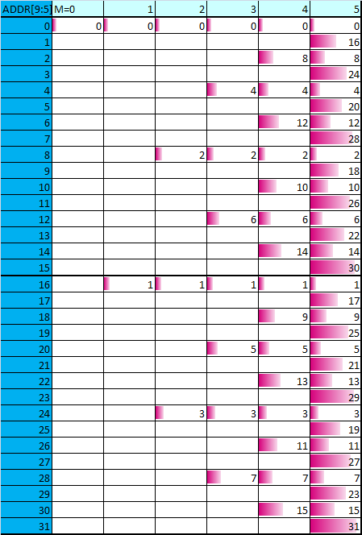
Event Buffer Layout
WA
9
8
7
6
5
4
3
2
1
0
M[2:0]=5
Nevt[0:4]
CNT[4:0]
M[2:0]=4
Nevt[0:3]
CNT[5:0]
M[2:0]=3
Nevt[0:2]
CNT[6:0]
M[2:0]=2
Nevt[0:1]
CNT[7:0]
M[2:0]=1
Nevt[0]
CNT[8:0]
M[2:0]=0
CNT[9:0]
The event buffer is subdivided as shown in the table.
The readout program in VME should address the event block in the sequence shown.

Slide 7
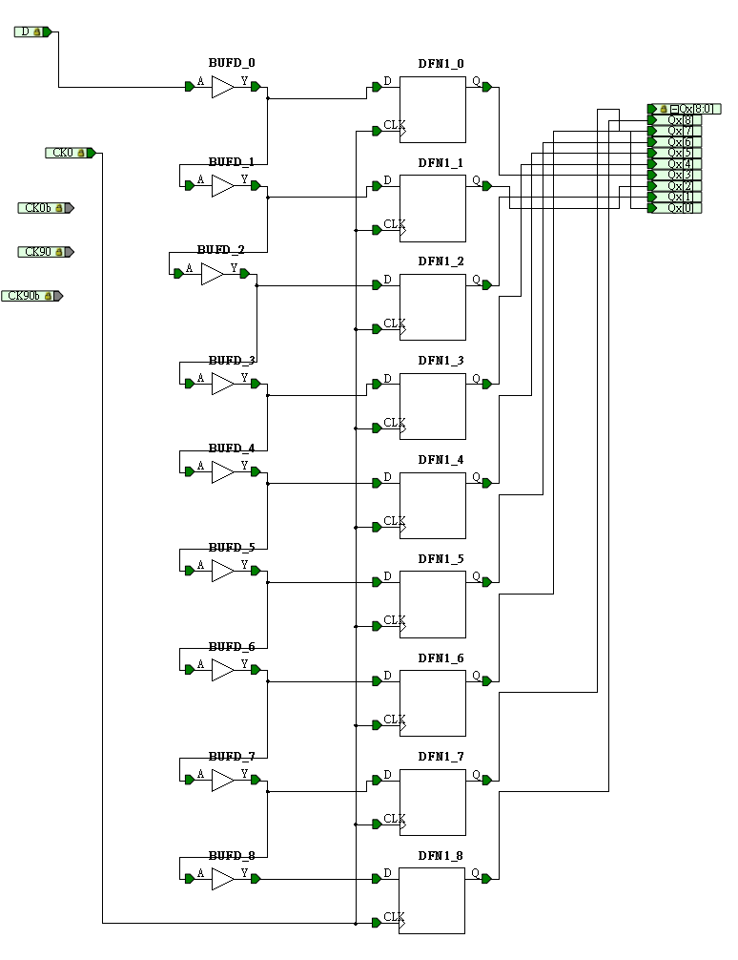
data resolution
250 MHz clock
9 phases
~0.444 ns resolution
1 | 10.26% | 410.32
2 | 11.89% | 475.47
3 | 10.22% | 408.74
4 | 12.30% | 491.83
5 | 10.41% | 416.55
6 | 11.16% | 446.48
7 | 9.55% | 382.18
8 | 10.42% | 416.88
9 | 13.79% | 551.53

Slide 8
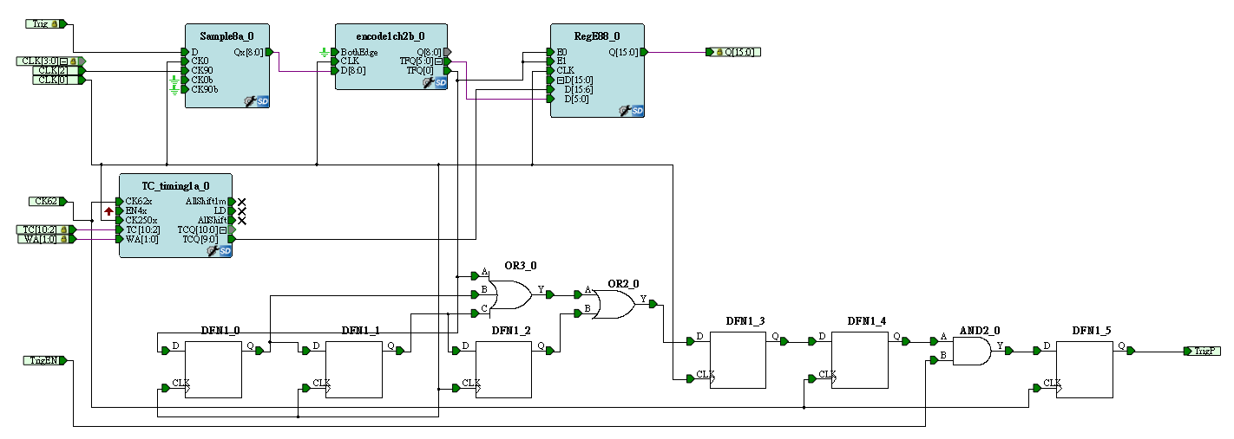
Trigger time resolution
The trigger time resolution is same with the data resolution.
Trigger time - Data time = TDC time

Slide 9
Current Design
Time resolution | ~0.44 ns
Two-hits resolution | 4 ns
Width of accepted window | 2us (user selected)
Edge detective | User selected leading edge only or both edges.
Maximum hits per trigger | User selected (32~1024)
Maximum events per IRQ | User selected (2~32)

Slide 10
Register Map
0x000 version (e9061206)
0x004 CSR
0x008 test area
0x1000~0x1ffc = event buffer (1k internal)
0x2000~0x2ffc = test area
?~? = dual port buffer (32 k)
D31-D16 | D08 | D7-5 | D2-0
EN4X (CSR) | BothEdge (Edge selection) | SEL(READ/WRITE addr) | M (buffer size)

Slide 11
DATA format
Header
D15 | D14 | D13 | D12 | D11 | D10 | D09 | D08 | D07 | D06 | D05 | D04 | D03 | D02 | D01 | D0
Trig [15:3] (trigger time) |  |  |  |  |  |  |  |  |  |  |  | Fine time
D31 | D30 | D29 | D28 | D27 | D26 | D25 | D24 | D23 | D22 | D21 | D20 | D19 | D18 | D17 | D16
1 | CNT[10:0] (number of hits) |  |  |  |  |  |  |  |  |  |  | 0 | 0 | 0 | positive or negative edge
Data
D15 | D14 | D13 | D12 | D11 | D10 | D09 | D08 | D07 | D06 | D05 | D04 | D03 | D02 | D01 | D0
TDC [15:4] (data time) |  |  |  |  |  |  |  |  |  |  |  | Fine time
D31 | D30 | D29 | D28 | D27 | D26 | D25 | D24 | D23 | D22 | D21 | D20 | D19 | D18 | D17 | D16
Cable: 4,5,6,7 |  |  |  | Channel number: 0-15 |  |  |  | Hit Id |  |  |  | 0 | 0 | 0 | positive or negative edge
Notes:
MSB = most significant bit

Slide 12
Main part test
fix tdc time, and apply cable-delay between each channel, with Multiple TDC in the VME-crate
Check if there is cross-talk between different channels
Check if tdc time stable in each channel
Check free running-internal-clock
Check if we drop any signal during the test
Shift signal to both edge of time window
to see if tdc are stable around the edge
Multiple signals in each channel

Slide 13
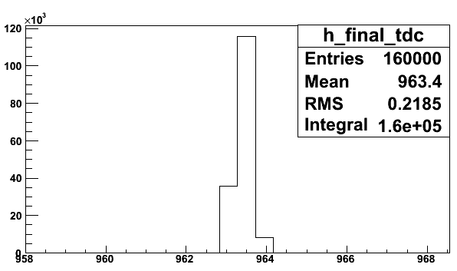
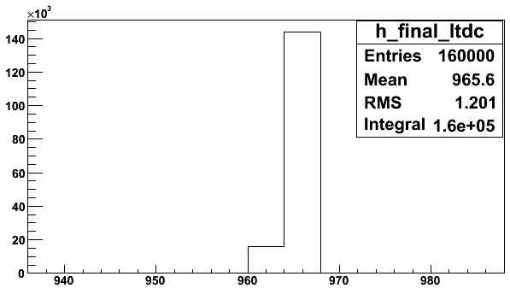
TDC main part test – Oct/2012

Slide 14
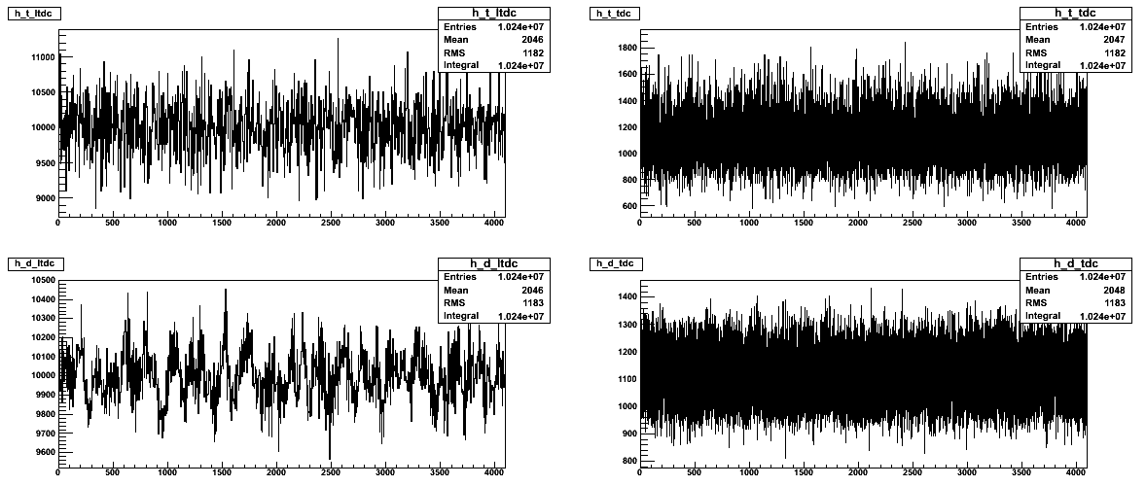
Random hit test for internal free running clock

Slide 15
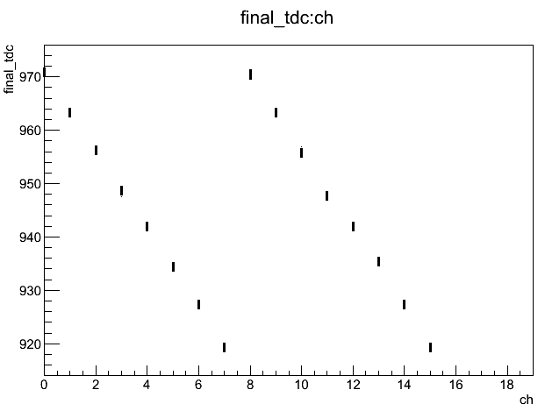
TDC main part test – Oct/2012

Slide 16
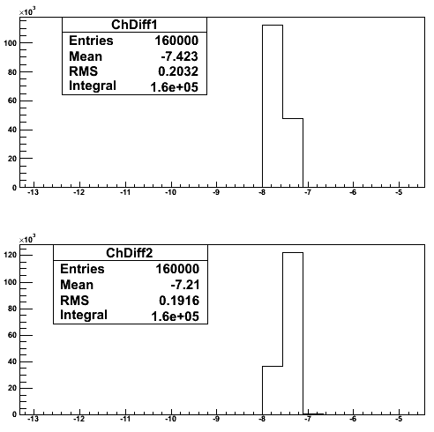
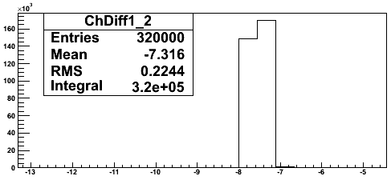
Cable delay between channels channel 0~7 = Channel 8~15
ch1
ch9
Ch1+Ch9

Slide 17
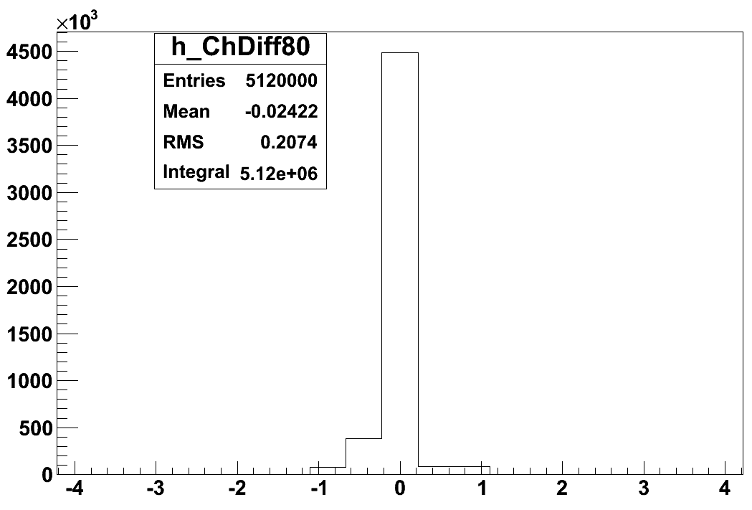
Cable delay between channels
Ch8 -Ch0
Ch9 -Ch1
Ch10-Ch2
Ch11-Ch3
Ch12-Ch4
Ch13-Ch5
Ch14-Ch6
Ch15-Ch7
……
……
Ch31- ch16
Ch47-ch32
Ch63-ch48

Slide 18
More test To do
Cosmic trigger (for real random hit test)
Calibration
Minimize the tdc time to check linearity problem (RMS of tdc vs ΔT)

Slide 19
Where are we …
The time information of data and trigger are tested
Time line
Sep/Oct: main-function test, building the production test system
Nov 2012: add future designs – time window cut and delay
Dec 2012 :Production test
Time diff between diff channels
Multiple pulses in each channel
full system - test vme noice feedback, with 12 TDCs in one VME crate
Jan 2013 :Fine tune with E906 detectors/cosmic ray

Slide 20
Thank you…

Slide 21
Backup

Slide 22
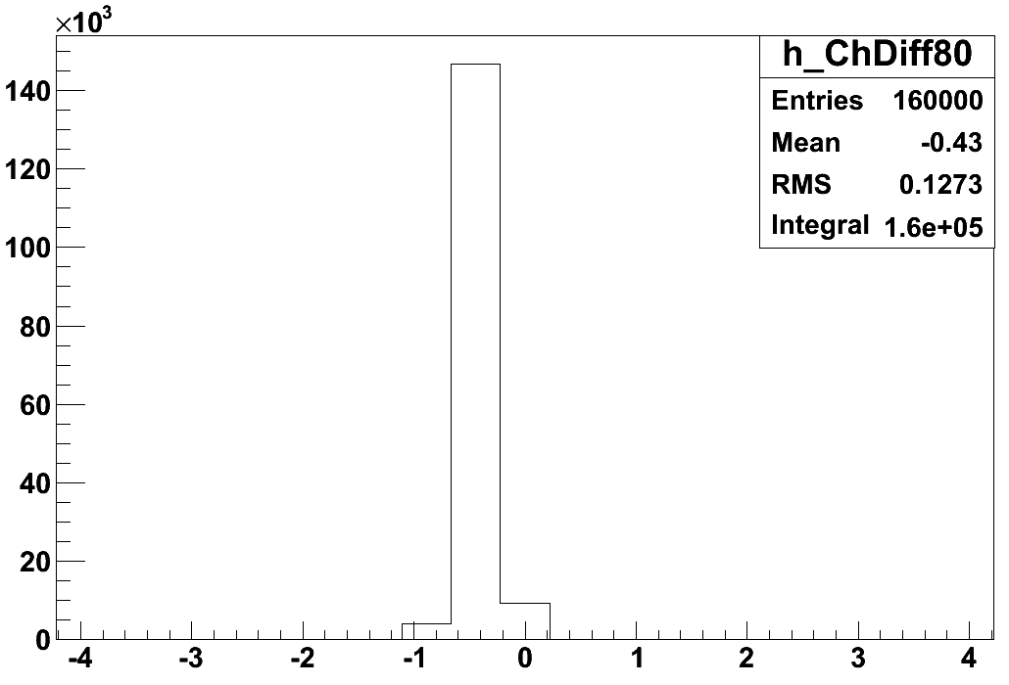
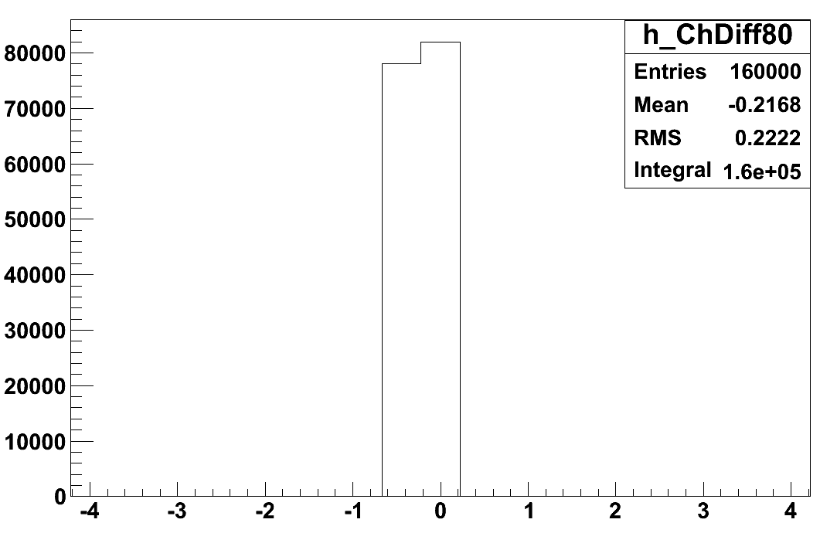
Ch8-Ch0 Ch9-Ch1

Slide 23
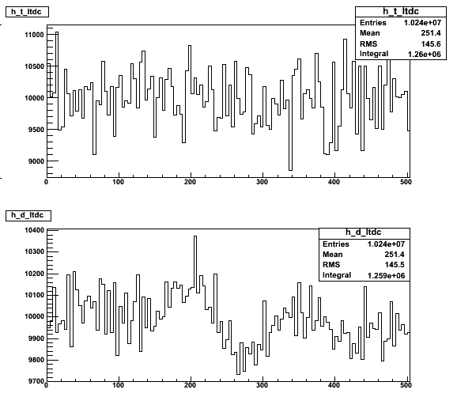
Random hit test for internal free running clock
Zoom in

Slide 24
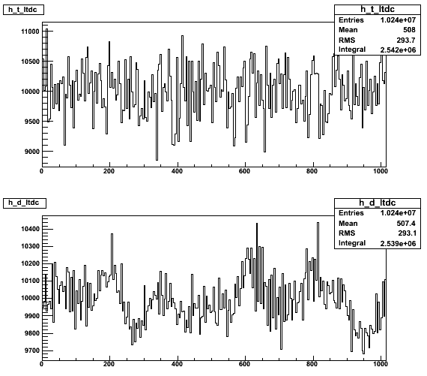
Random hit test for internal free running clock
Zoom in

Slide 25
Data Throughput (worst case scenario)
Assume 100% occupancy each channel will output 4 Byte per event. (32 bits for and channel information of one hit)
For each card: 4*64 = 256 byte per event
For a system with 100 cards: 25.6KB per event
Assume trigger rate 2KHz : 51.2 MB/s (for only one card is 0.05 MB/s)
A Gigabit Ethernet support at 1 Gbps (1000 Mbps =125 MBps)
VME backplane speed for BLT32 =25MBytes/s (25Bytes/us) = (10 us to readout each TDC/event) (worst case scenario)
Notes:
The old TDC without zero suppression is ~ 1k bytes per event, which took ~90us to read out

Slide 26
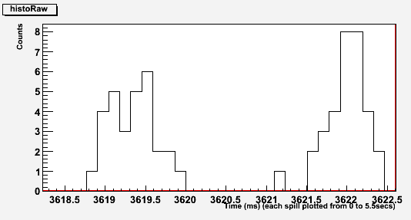
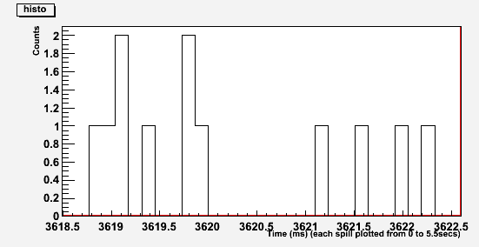
Beam structure
137us bin size
Before Inhibit
Bin size =137 us
Dead time was 680 us in the Run1
If the deadtime is 90us (70 us?), the dead part will decrease a lot …
After Inhibit

Slide 27
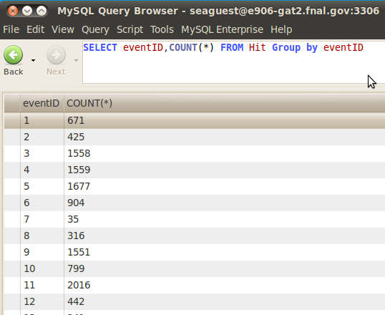
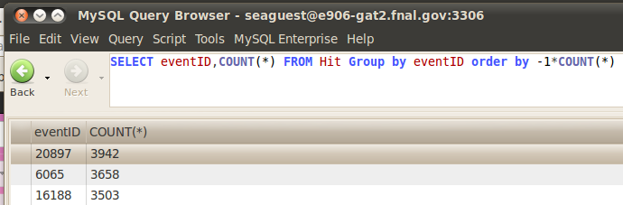
Real case
In the final run (2173) in Run1
The Max number of hit is less than 4000
In the worth case scenario, 4000 hits per events. For one event we get 4* 4000 =16KB
we were assumeing 25.6KB on last page
so that, in the real run, the deadtime is much lower than what we estimated

Slide 28
CIP (copy in progress) free: 2~32 buffer to store data during CIP. Data still can be record during CIP.

Slide 29
Transfer type | Speed
BLT32 | 25 MBytes/s
MBLT64 | 50 MBytes/s
2e VME | 88 MBytes/s

Slide 30
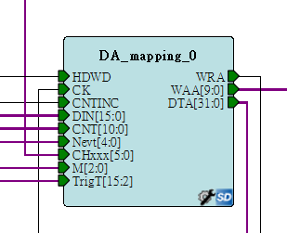
User selected buffer size
Maximum hits per trigger (32~1024)
Maximum events per IRQ (1~32)

Slide 31
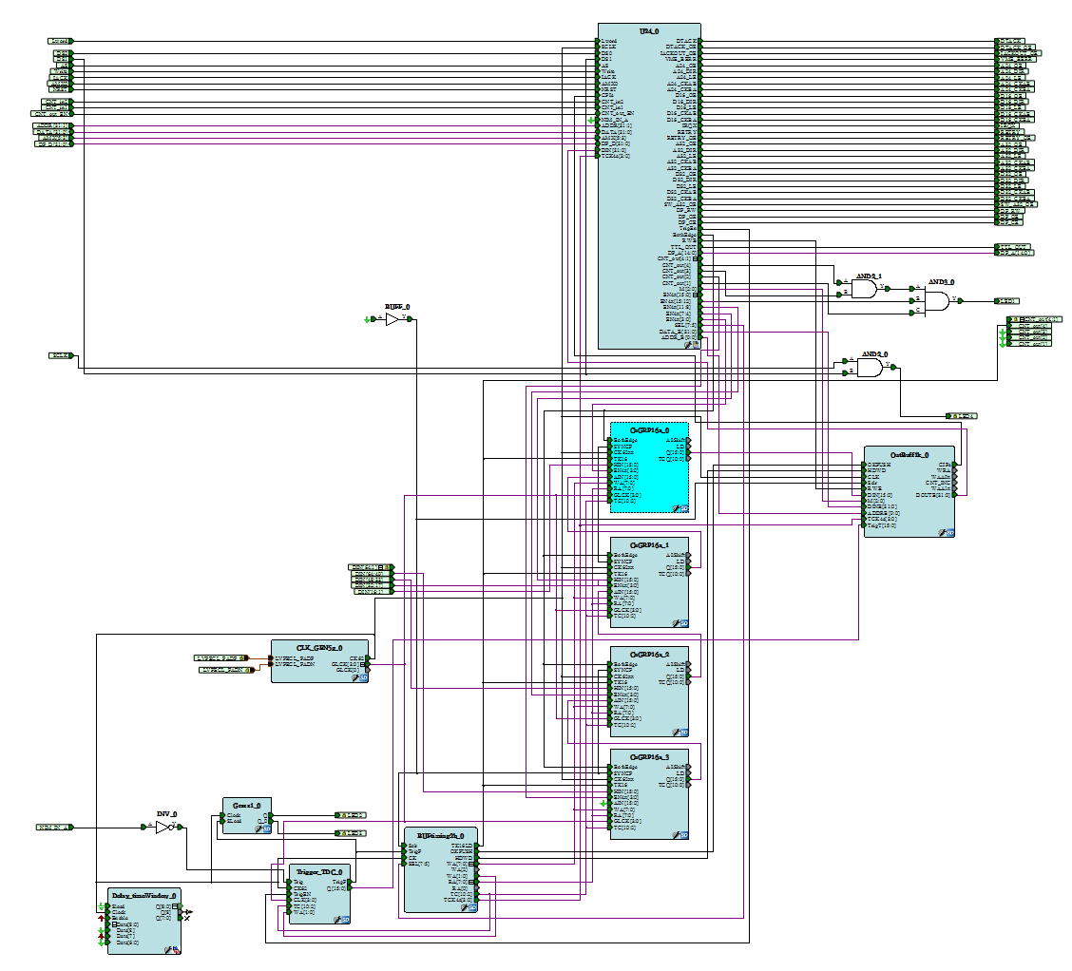
Third layer buffer
Second layer buffer
First layer buffer

Slide 32
3 layers buffers
First layer buffer
second layer buffer
Third layer buffer

Slide 33
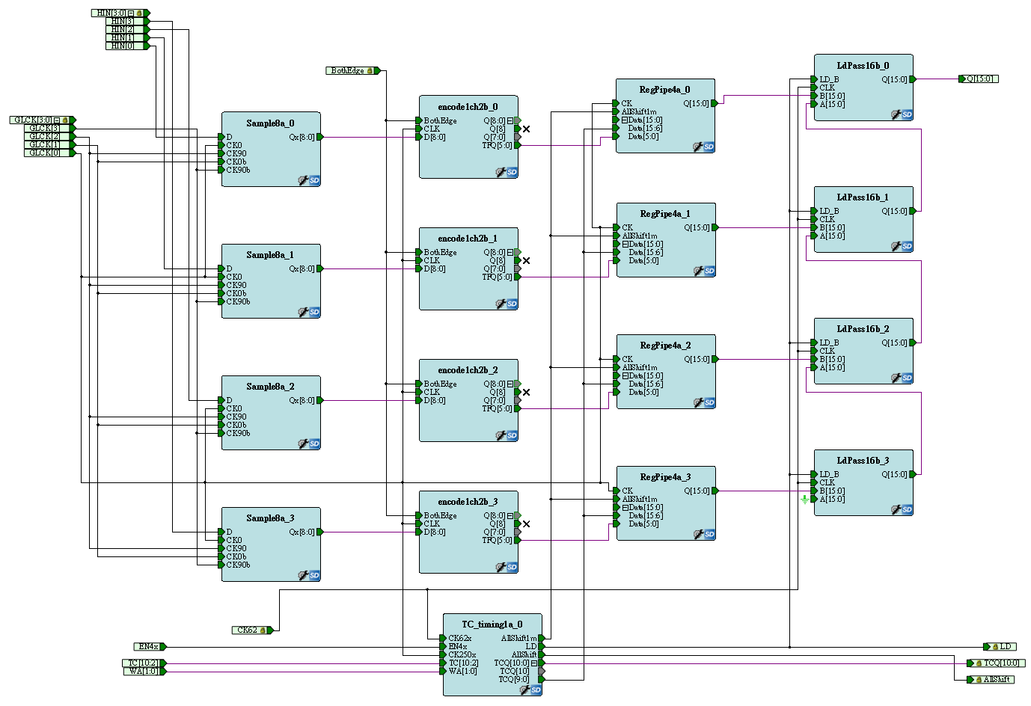
First layer buffer
4 hits per channel,
Buffer pushing: Any clock cycle at 250 MHz.
Buffer popping: 1 hit/64 ns.
RegPipe4a/ChGRP4a
Notes:
nothing to do with trigger

Slide 34
Second layer buffer
Second layer buffer, every 4 channels share a circular buffer
(Page size)*(Number of Pages) = 256, user defined.
Hits fill into a page continuously.
When a trigger is received, hits are filled to next page and the current page is copied to the third layer buffer. The sequence is called copy in progress (CIP).
(e.g. Page size=128 , CIP =128* 16 = 2048 clock cycle =2048 *16ns = 32us) (worth case scenario)
SRAM256x16/ ChGRP16a
Notes:
(CIP/ writing is trigger free/readout related to trigger)

Slide 35
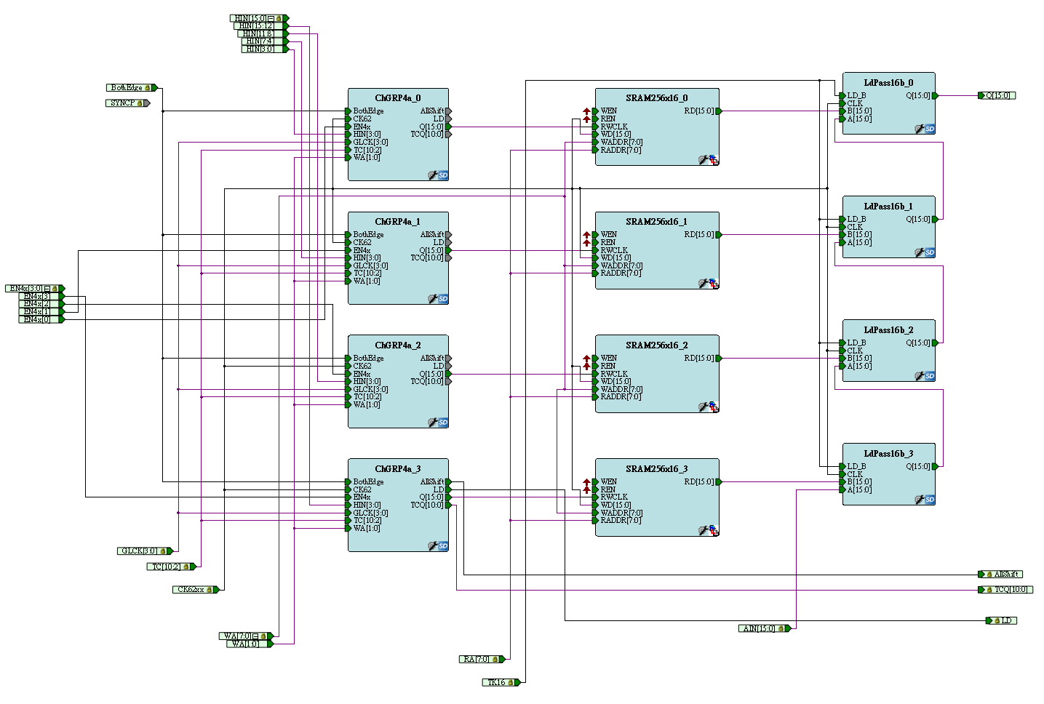
Second layer buffer
SRAM256x16/ ChGRP16a

Slide 36
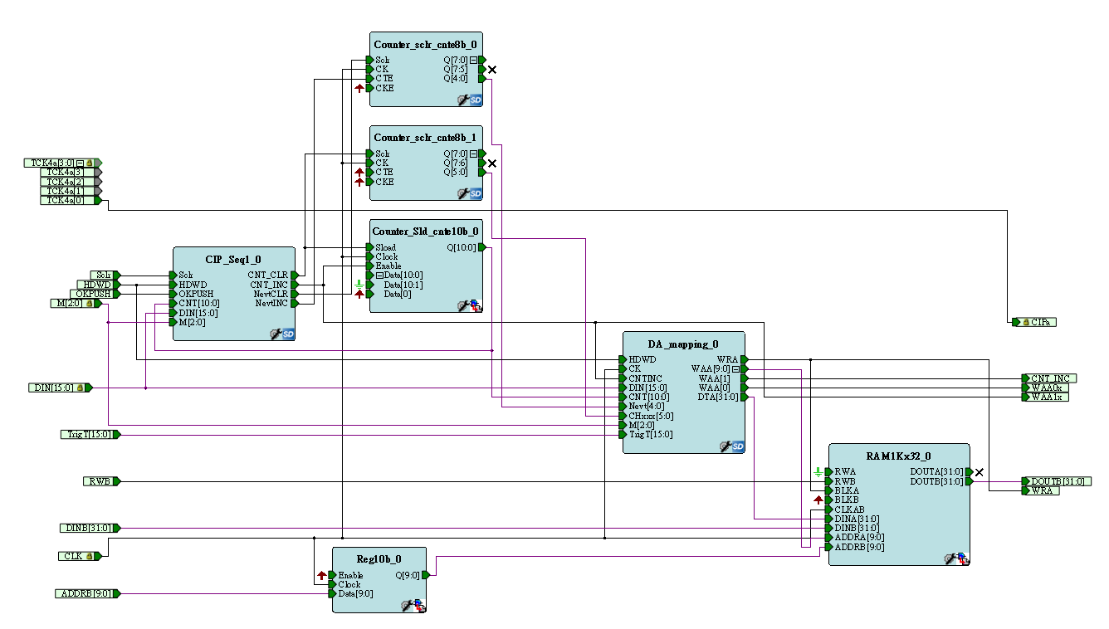
Third layer buffer
Buffer size =1 K
(Page size)*(Number of Pages) = 1024, user defined.
Hit filling during CIP
Readout from VME IRQ
Outbuffer1k

Slide 37
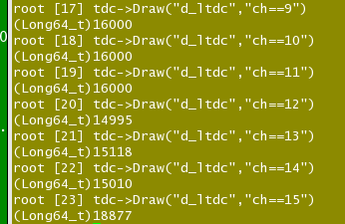
Fixed problem (Sep. 2012)
Some channels droped the hits, and some channel picked them up
This problem is fixed by adding one more clock cycle

